Slide 1
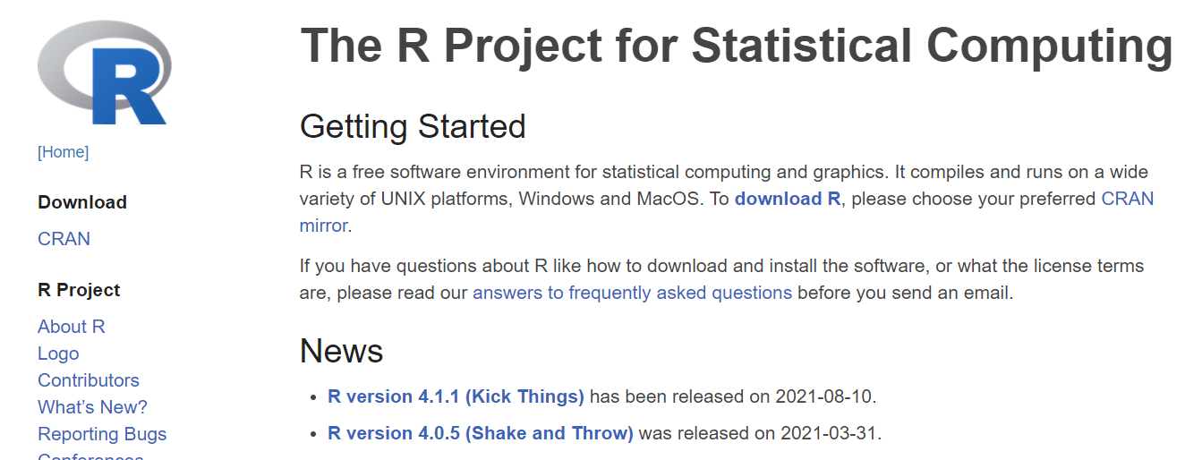
1. Click “download R”
Note: new versions are released a few times a year

